Slide 1

MICROARCHITECTURAL ATTACKS Vitaly Shmatikov
Credit for many slides: Stanford CS 155

Slide 2





Isolation in Modern Systems
Process cannot read memory of another process
User-level code cannot read memory of the OS kernel
JavaScript cannot read memory of the Web browser outside its sandbox
Virtual machine cannot read memory of another virtual machine
Code outside an SGX enclave cannot read memory protected by SGX

Slide 3
Performance in Modern CPUs
Clock speed maxed out
Pentium 4 reached 3.8 GHz in 2004
Memory latency is slow and not improving much
To gain performance, need to do more per cycle…
Reduce memory delays: caches
Work during delays: speculative execution
While waiting to determine the value of a condition, guess which branch to take, execute, throw out results if guess is wrong

Slide 4
Memory Caches
Caches hold local (fast) copy of recently accessed 64-byte chunks of memory
CPU
Sends address, Receives data
MEMORY
CACHE
Set | Addr | Cached Data ~64B
0 | F0016280 31C6F4C0 339DD740 614F8480 | B5 F5 80 21 E3 2C.. 9A DA 59 11 48 F2.. C7 D7 A0 86 67 18.. 17 4C 59 B8 58 A7..
1 | 71685100 132A4880 2A1C0700 C017E9C0 | 27 BD 5D 2E 84 29.. 30 B2 8F 27 05 9C.. 9E C3 DA EE B7 D9.. D1 76 16 54 51 5B..
2 | 311956C0 002D47C0 91507E80 55194040 | 0A 55 47 82 86 4E.. C4 15 4D 78 B5 C4.. 60 D0 2C DD 78 14.. DF 66 E9 D0 11 43..
3 | 9B27F8C0 8E771100 A001FB40 317178C0 | 84 A0 7F C7 4E BC.. 3B 0B 20 0C DB 58.. 29 D9 F5 6A 72 50.. 35 82 CB 91 78 8B..
4 | 6618E980 BA0CDB40 89E92C00 090F9C40 | 35 11 4A E0 2E F1.. B0 FC 5A 20 D0 7F.. 1C 50 A4 F8 EB 6F.. BB 71 ED 16 07 1F..
MAIN MEMORY
Address:
132E1340
Addr: 2A1C0700
Data:
AC 99 17 8F 44 ..
Big, slow
(e.g. 16GB SDRAM)
hash(addr) to map to cache set
Fast
2A1C0700
Data: 9E C3 DA EE B7 D3..
Addr: 132E1340
Data: AC 99 17 8F 44 09..
Slow
Reads change system state:
Read to newly-cached location is fast
Read to evicted location is slow
Addr: 132E1340
Fast
Evict to make room
132E1340
AC 99 17 8F 44 09..
Data: AC 99 17 8F 44 09..

Slide 5
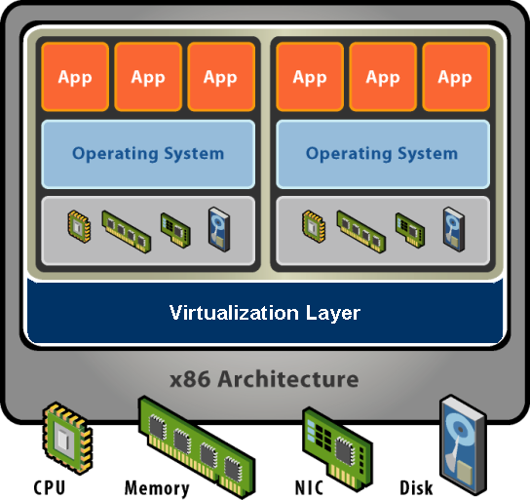

Virtual Machine
Software abstraction
Behaves like hardware
Encapsulates all OS and application state
Virtualization layer
Extra level of indirection
Decouples hardware, OS
Enforces isolation
Multiplexes physical hardware across VMs

Slide 6

Cache Contention
Same hardware cache used by victim and attacker
Attacker VM
Main
memory
Victim VM
CPU data cache
1) Read in a large array (fill CPU cache with attacker data)
2) Busy loop (allow victim to run)
3) Measure time to read large array (load measurement)
Locations in cache occupied by victim will take longer to load
Information about victim’s use of cache revealed to attacker

Slide 7

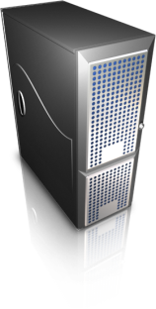

Cross-VM Side Channel
Secret key
Secret 4096-bit encryption key
Modular Exponentiation (x, e, N):
let e_{n} … e₁ be the bits of e
y ← 1
for e_{i} in {e_{n} …e₁}
y ← Square(y) (S)
y ← Reduce(y, N) (R)
if e_{i} = 1 then
y ← Multi(y, x) (M)
y ← Reduce(y, N) (R)
return y // y = x^{e} mod N
If e_{i} = 1, execute “SRMR”
If e_{i} = 0, execute “SR”
Sequence of function calls
reveals secret key
ElGamal encryption algorithm

Slide 8


Prime + Probe
Attacker VM
CPU cache
(each row represents cache set)
Victim VM
Main
memory
Interrupt
Runs (S) operation
Attacker VM
…
Victim VM
Timings correlated to (distinct) cache usage patterns of S, M operations
Can spy frequently (every ~16 μs) by exploiting scheduling
Interrupt
Runs (M) operation
Attacker VM
Scheduling
order on
CPU core
…

Slide 9
Attack Stages
Stage 1
Stage 2
Cross-VM Side Channel Probing
Vectors of cache measurements
Cache Pattern Classification
Sequences of SVM-classified labels
Noise Reduction
Fragments of code path
Code-Path Reassembly
Stage 3
Stage 4

Slide 10
Prime + Probe Feasibility
Setup for in-lab experimentation:
Intel Yorkfield processor (4 cores, 32KB L1 instruction cache)
Xen + Linux + GnuPG + libgcrypt
Best result:
300,000,000 prime-probe results (6 hours)
Over 300 key fragments
Brute force the secret key in ~9800 guesses
Not practical in deployment settings
State-of-the-art Prime+Probe attacks:
Sinan Inci et al. 2016 “Cache Attacks Enable Bulk Key Recovery on the Cloud”

Slide 11

Flush + Reload
Attacker VM
Fast
L1 instruction cache
Runs (S)
operation
Victim VM
flush
Main
memory
Yuval Yarom
Interrupt
flush
S instr
Attacker VM
flush
flush
Slow
M instr
Each row represents a cache set
Fast time on S instr means victim performed S op
Scheduling order on CPU core
Yarom and Faulkner (2013)

Slide 12
Flush + Reload
Attacker VM
Fast
L1 instruction cache
Runs (S)
operation
Victim VM
Main
memory
Interrupt
S instr
Attacker VM
Slow
Runs (M)
operation
Victim VM
M instr
Each row represents a cache set
Interrupt
Attacker VM
Fast time on M instr means victim performed M op
Scheduling order on CPU core

Slide 13
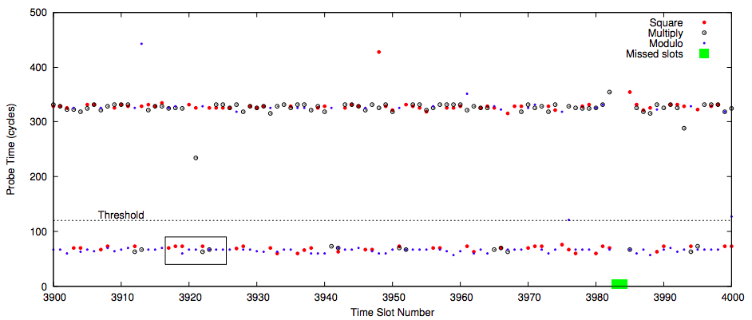
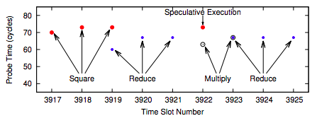
Attacking Square-and-Multiply
Modular Exponentiation (x, e, N):
let e_{n} … e₁ be the bits of e
y ← 1
for e_{i} in {e_{n} …e₁}
y ← Square(y) (S)
y ← Reduce(y, N) (R)
if e_{i} = 1 then
y ← Multi(y, x) (M)
y ← Reduce(y, N) (R)
return y // y = x^{e} mod N

Slide 14
Speculative Execution
Slow
if (uncached_value == 1) // load from memory
a = compute(b)
Must wait to execute this code until if() is known
Branch predictor guesses if() is true based on past history
CPU speculatively executes compute(b) while value is being loaded
After value arrives from memory…
Guess correct: save speculative work, performance gain (!!)
Incorrect: discard speculative work, ho harm (??)

Slide 15
Problem: Side Effects
Architectural Guarantee:
Register values eventually match the result of in-order execution
Speculative execution:
CPU performs incorrect calculations, then deletes mistakes
Is making, then discarding mistakes
the same as in-order execution?
The processor executed instructions that were not supposed to run !!
The problem: these instructions can have observable side-effects
Notes:
Prior history: branch predictor.

Slide 16

Spectre and Meltdown
Speculative execution bugs in Intel x86, ARM, IBM processors + cache-based side channels (Flush+Reload)
Consequences: break memory protection and isolation in kernels, JavaScript sandboxes, hypervisors, other VMs, trusted execution enclaves (SGX), etc.
Notes:
Prior history: branch predictor.

Slide 17
Conditional Branch Attack (Variant 1)
if (x < array1_size)
y = array2[array1[x]*4096];
Suppose unsigned int x comes from an untrusted caller
Execution without speculation is safe:
array2[array1[x]*4096] not evaluated unless x < array1_size
What about with speculative execution?

Slide 18
Conditional Branch Attack (Variant 1)
if (x < array1_size)
y = array2[array1[x]*4096];
Memory & Cache Status
array1_size = 00000008
Memory at array1 base:
8 bytes of data (value doesn’t matter) Memory at array1 base+1000:
09 F1 98 CC 90...(something secret)
array2[ 0*4096]
array2[ 1*4096]
array2[ 2*4096]
array2[ 3*4096]
array2[ 4*4096]
array2[ 5*4096]
array2[ 6*4096]
array2[ 7*4096]
array2[ 8*4096]
array2[ 9*4096]
array2[10*4096]
array2[11*4096]
Before attack:
Train branch predictor to expect if() is true (e.g. call with x < array1_size)
Evict array1_size and array2[] from cache
Contents don’t matter
only care about cache status
Uncached
Cached
• • •

Slide 19
Conditional Branch Attack (Variant 1)
if (x < array1_size)
y = array2[array1[x]*4096];
Memory & Cache Status
array1_size = 00000008
Memory at array1 base:
8 bytes of data (value doesn’t matter) Memory at array1 base+1000:
09 F1 98 CC 90...(something secret)
array2[ 0*4096]
array2[ 1*4096]
array2[ 2*4096]
array2[ 3*4096]
array2[ 4*4096]
array2[ 5*4096]
array2[ 6*4096]
array2[ 7*4096]
array2[ 8*4096]
array2[ 9*4096]
array2[10*4096]
array2[11*4096]
Attacker calls victim with x=1000
Speculative exec while waiting for array1_size:
Predict that if() is true
Read address (array1 base + x) (using out-of-bounds x=1000)
Read returns secret byte = 09 (in cache ⇒ fast )
Contents don’t matter
only care about cache status
Uncached
Cached
• • •

Slide 20
Conditional Branch Attack (Variant 1)
if (x < array1_size)
y = array2[array1[x]*4096];
Memory & Cache Status
array1_size = 00000008
Memory at array1 base:
8 bytes of data (value doesn’t matter) Memory at array1 base+1000:
09 F1 98 CC 90...(something secret)
array2[ 0*4096]
array2[ 1*4096]
array2[ 2*4096]
array2[ 3*4096]
array2[ 4*4096]
array2[ 5*4096]
array2[ 6*4096]
array2[ 7*4096]
array2[ 8*4096]
array2[ 9*4096]
array2[10*4096]
array2[11*4096]
Attacker calls victim with x=1000
…
Request mem at (array2 base + 09*4096)
Bring array2[09*4096] into the cache
Realize if() is false, discard speculative work
Finish operation and return to caller
Contents don’t matter
only care about cache status
Uncached
Cached
• • •

Slide 21
Conditional Branch Attack (Variant 1)
if (x < array1_size)
y = array2[array1[x]*4096];
Memory & Cache Status
array1_size = 00000008
Memory at array1 base:
8 bytes of data (value doesn’t matter) Memory at array1 base+1000:
09 F1 98 CC 90...(something secret)
array2[ 0*4096]
array2[ 1*4096]
array2[ 2*4096]
array2[ 3*4096]
array2[ 4*4096]
array2[ 5*4096]
array2[ 6*4096]
array2[ 7*4096]
array2[ 8*4096]
array2[ 9*4096]
array2[10*4096]
array2[11*4096]
Attacker calls victim with x=1000
…
Measures read time for array2[i*4096] for all i
Read for i=09 is fast (because cached!), reveals the value of the secret byte
Repeat with many x (10KB/s)
Contents don’t matter
only care about cache status
Uncached
Cached
• • •

Slide 22
Violating JavaScript Sandbox
Browsers run JavaScript from untrusted websites, JIT compiler inserts bounds checks on array accesses
Speculative execution runs through safety checks…
JIT thinks this check ensures index < length, so it omits bounds check in next line. Separate code evicts length for attack passes
index will be in-bounds on training passes, and out-of-bounds on attack passes
Do the out-of-bounds read on attack passes!
if (index < simpleByteArray.length) {
index = simpleByteArray[index | 0];
index = (((index * TABLE1_STRIDE)|0) & (TABLE1_BYTES-1))|0;
localJunk ^= probeTable[index|0]|0;
}
“|0” is a JS optimizer trick (makes result an integer)
4096 bytes = memory page size
Need to use the result so the operations aren’t optimized away
Keeps the JIT from adding unwanted bounds checks on the next line
Leak out-of-bounds read result into cache state!
Evict length/probeTable from JavaScript (easy), then use timing to detect newly-cached location in probeTable

Slide 23
Indirect Branches (Variant 2)
Indirect branches can go anywhere, e.g., jmp[rax]
If destination is delayed, CPU guesses and proceeds speculatively
Find an indirect jmp with attacker-controlled register(s), then cause mispredict to a useful ‘gadget’
y = array2[array1[x]*4096];
Attack steps:
Mistrain branch prediction so speculative execution will go to gadget
Evict address [rax] from cache to cause speculative execution
Execute victim so it runs gadget speculatively
Detect change in cache state to infer memory contents

Slide 24
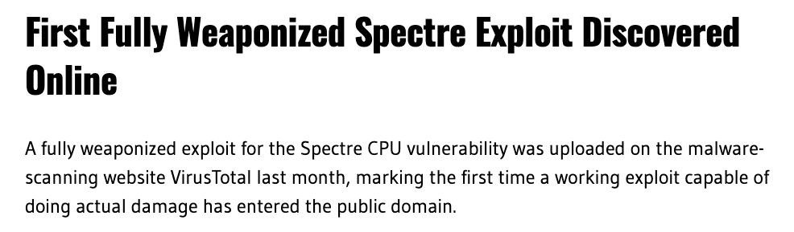
March 1, 2021
Can dump /etc/shadow password file
https://therecord.media/first-fully-weaponized-spectre-exploit-discovered-online/

Slide 25
Mitigating Spectre: Restore Cache State
Idea: fully restore cache state when speculation fails
Insecure! Speculative execution can have observable side effects beyond the cache state
if (x < array1_size) {
y = array1[x];
do_something_observable(y);
}
occupy a bus (detectable from another core),
or cause EM radiation

Slide 26
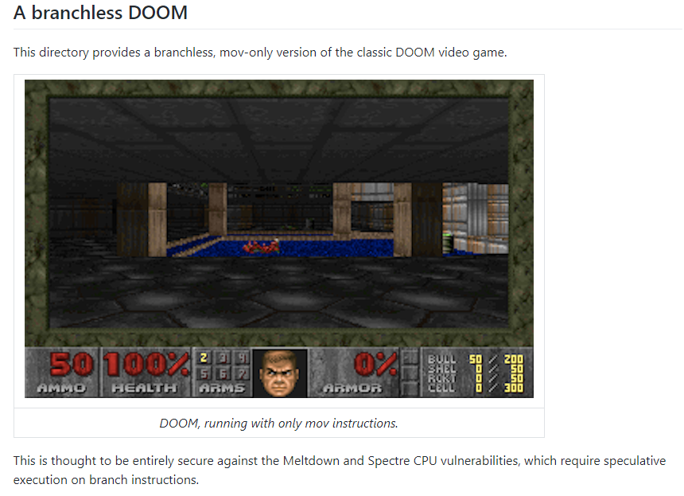
Mitigating Spectre: Remove All Branches?
DOOM with no branches:
one frame every ~7 hours

Slide 27
Mitigating Spectre: Stop Speculation
if (x < array1_size)
LFENCE // processor instruction
y = array2[ array1[x]*4096 ];
Idea: insert LFENCE on all vulnerable code paths
Efficient, no impact on benchmark software
Transfers blame from CPU to software: “should of put an LFENCE here!”
Often millions of control flow paths
Too confusing - speculation runs 188++ instructions, crosses modules
Too risky – miss one and attacker can read entire process memory
Insert LFENCEs manually?
Put LFENCES everywhere?
Abysmal performance - LFENCE is very slow
Not in binary libraries, compiler-created code patterns
Protect only known bad patterns = unsafe
Microsoft Visual C/C++ /Qspectre unsafe for 13 of 15 tests
⇒ Protect all potentially exploitable patterns
✓
Insert by smart compiler?

Slide 28
Meltdown
Intuition
1 raise_exception();
2 // the line below is never reached
3 access(probe_array[data * 4096]);

Slide 29
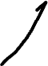
Meltdown: Core Spy Code
1 rcx = kernel address
2 rbx = probe array
3 retry:
4 mov al, byte [rcx]
5 shl rax, 0xc
6 jz retry
7 mov rbx, qword [rbx + rax]
Retry reading privileged memory
Access privileged memory
Multiply by page size
Read from an attacker’s (unprivileged) array at (secret value) * 2¹²
Attacker times accessing [rbx + rax] for different values of rax
When finds one that loads fast, learns sensitive byte

Slide 30
Meltdown Mitigation
KAISER/KPTI (kernel page table isolation):
remove kernel memory mapping in user-space processes
Some performance impact
Some kernel memory still needs to be mapped

Slide 31
More Attacks
Foreshadow
Rogue inflight data load (RIDL) and Fallout
ZombieLoad
Store-to-leak forwarding
All enable reading unauthorized memory (client, cloud, SGX)
Mitigating incurs significant performance costs

